Slide 1

Data Visualization & Analysis
GROUP A
Chandan Acharya
Devendra Hupri
Doriel Habasllari
Nagesh TR

Slide 2

Dataset used
World Data Bank
It is the primary World Bank collection of development indicators, compiled from officially recognized international sources. It presents the most current and accurate global development data available, and includes national, regional and global estimates.
Link: http://databank.worldbank.org/data/home.aspx

Slide 3
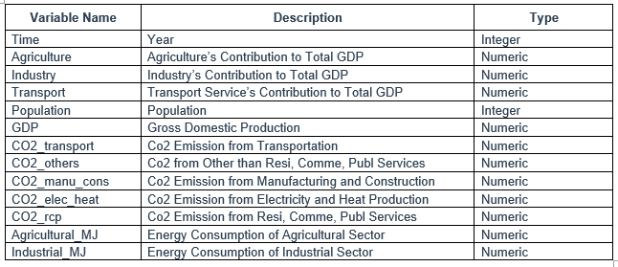
Variables

Slide 4
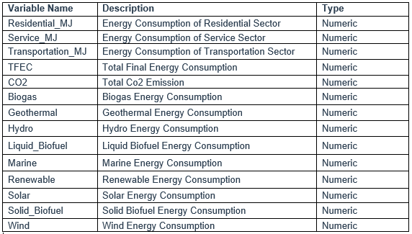
Variables

Slide 5
Problem Addressed
Impact of GDP and Transport Fuel Consumption
on CO2 Emission

Slide 6
Method used
ANOVA: Analysis of Variance
Analysis of variance (ANOVA) is a collection of statistical models used to analyse the differences among group means and their associated procedures

Slide 7
DEMONSTRATION
file:///E:/Masters/Semester_3/LAB/Project/Latest/gdp_energy_co2.html

